Slide 1
Spatial Data Analysis
Project submitted By: Aveek Das (20250004)
Module: CS621B Spatial Databases

Slide 2
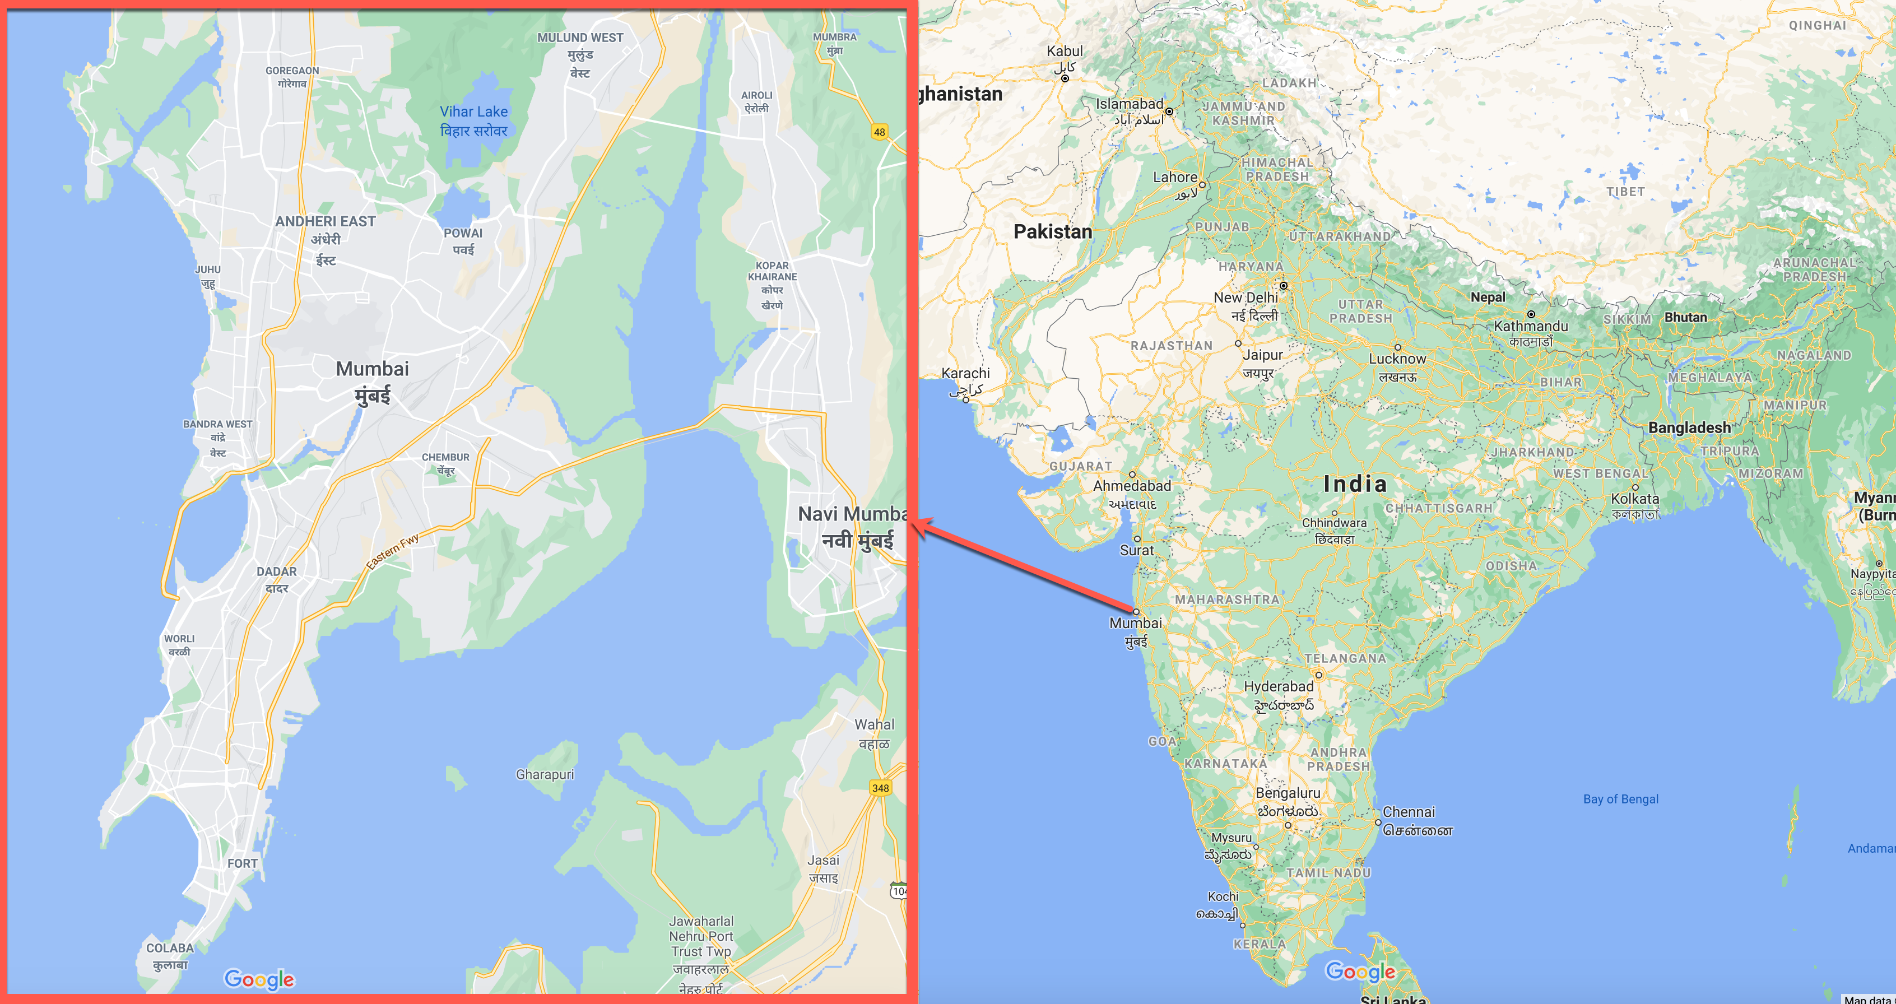
Spatial Analysis of houses in Mumbai
Mumbai is the economic capital of India.
We will try to find out best locations to purchase houses based on conditions

Slide 3
Motivation
My cousin wants to purchase an apartment in Mumbai.
The conditions for choosing a location:
Should be under budget.
Apartment should be within 5kms from Mumbai International Airport.
It should be near the beach and sea-facing.
Fastest route to Mumbai Travel Dockyard.

Slide 4
Analysis
To aid her search, we will analyze the following.
Visualize all the available apartments on the map.
Analyze the apartments by price range.
Find places within the 5km range of the airport.
Select sea facing apartments in that 5km radius.
Finally, select an apartment and calculate the fastest route to Naval Dockyard.

Slide 5
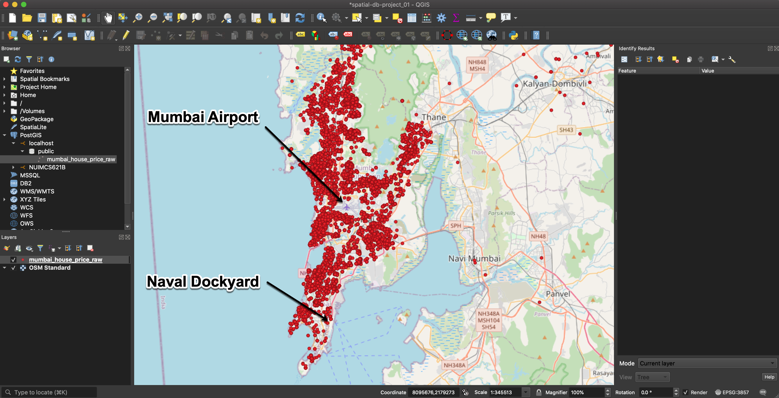
Analysis Visualize all available apartments on the map

Slide 6
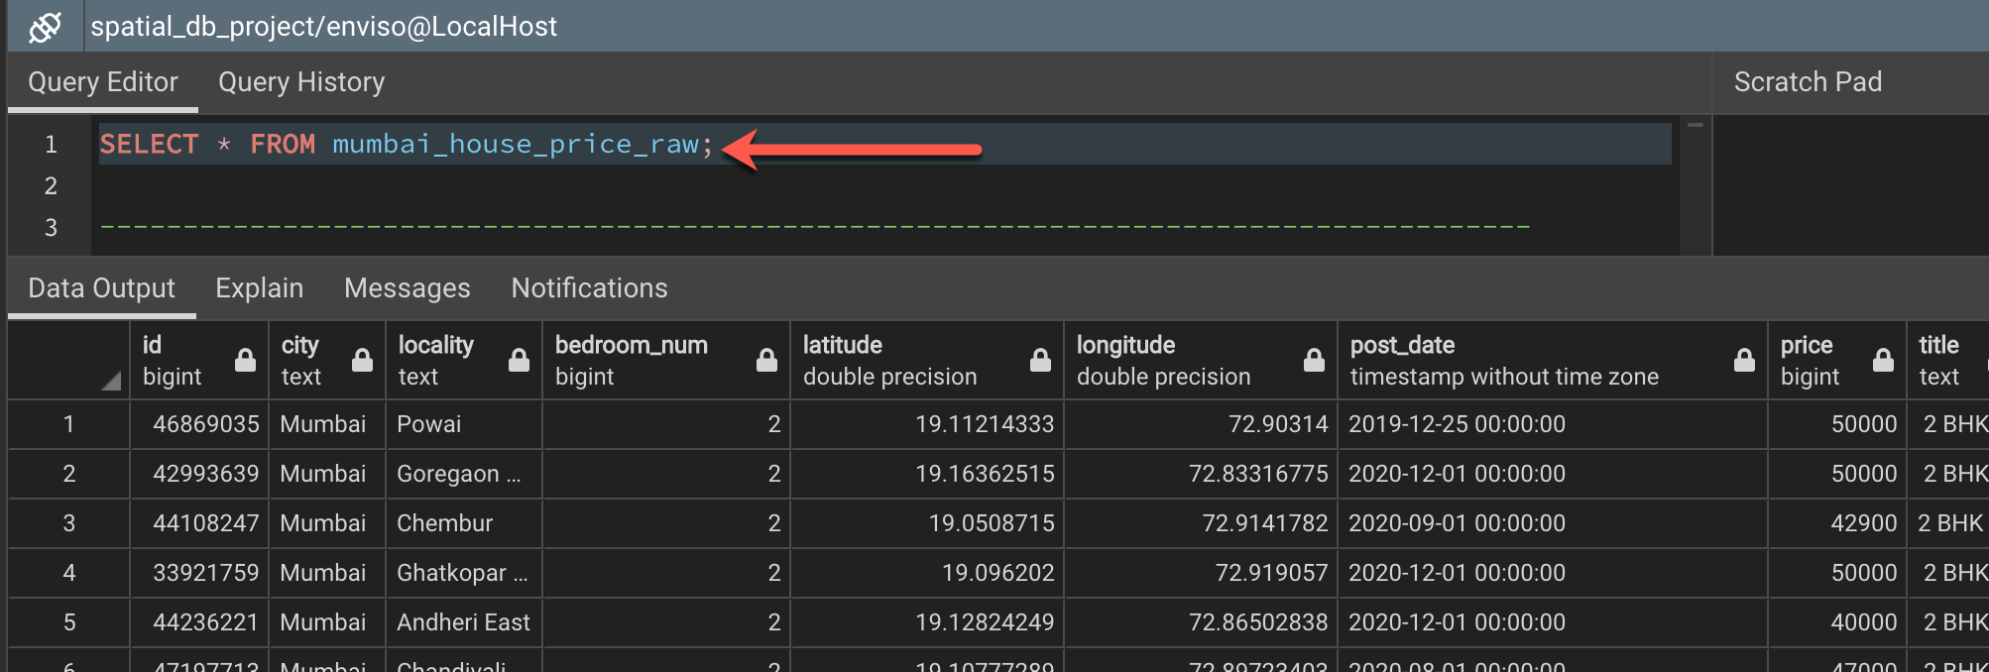
Analysis Visualize all available apartments on the map

Slide 7
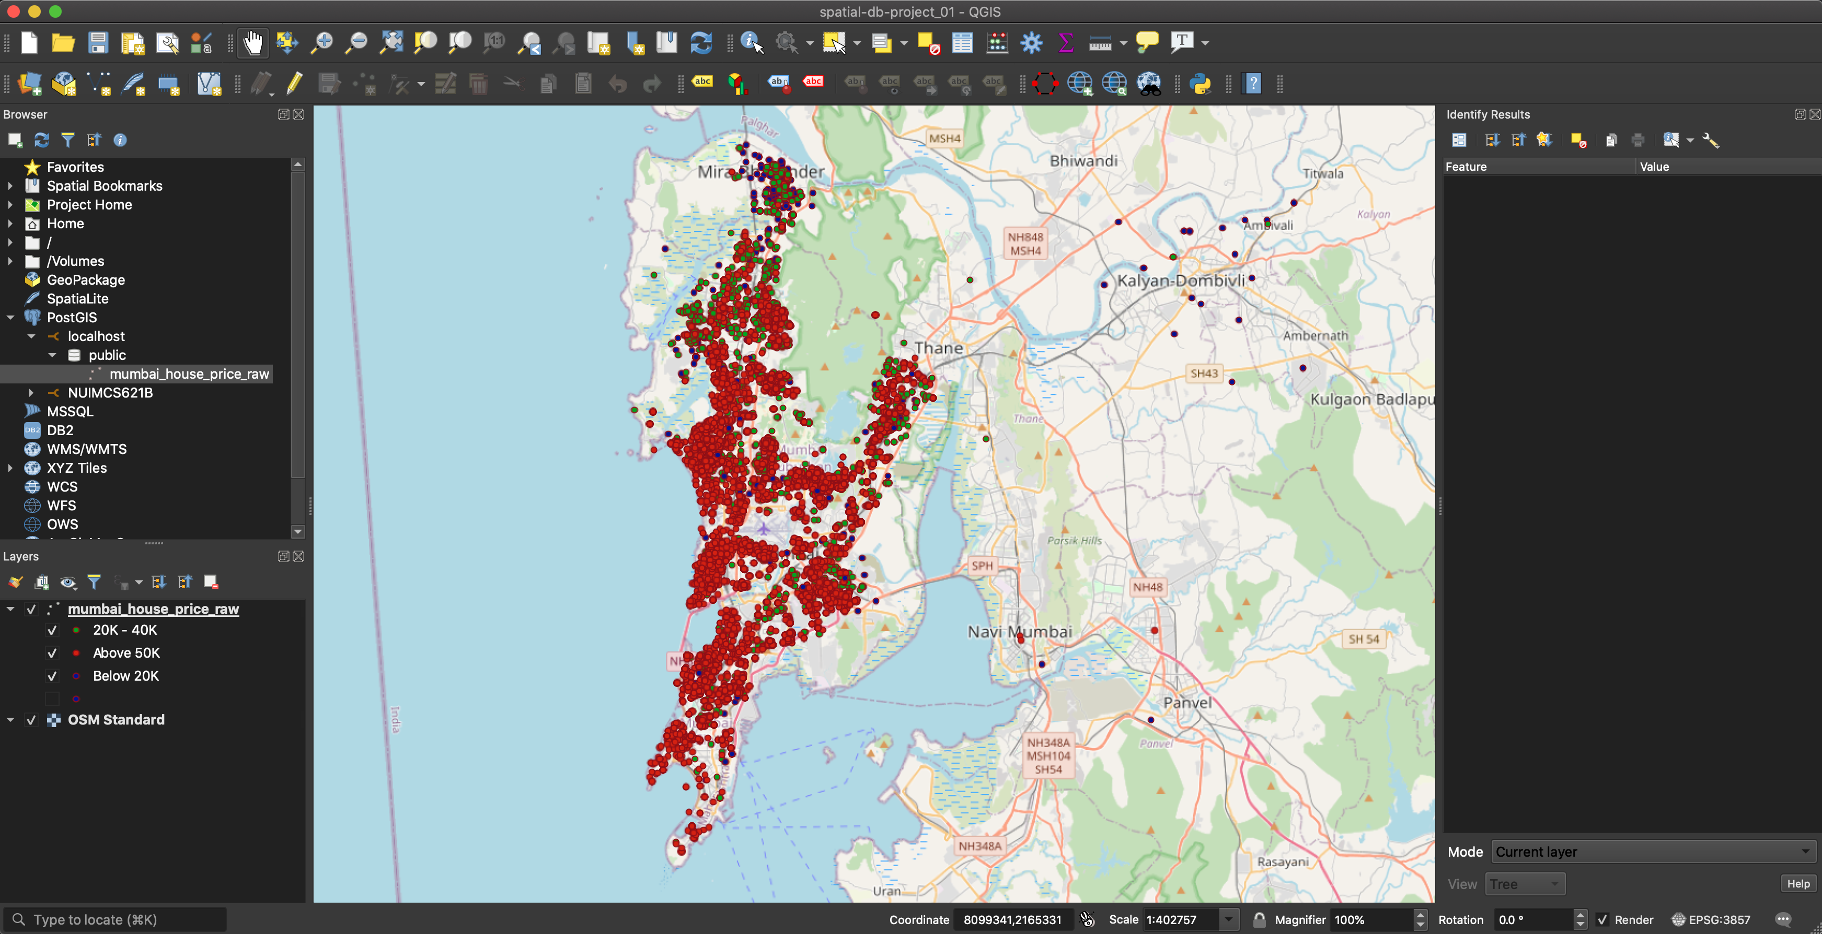
Analysis Analyze the apartments by price range

Slide 8
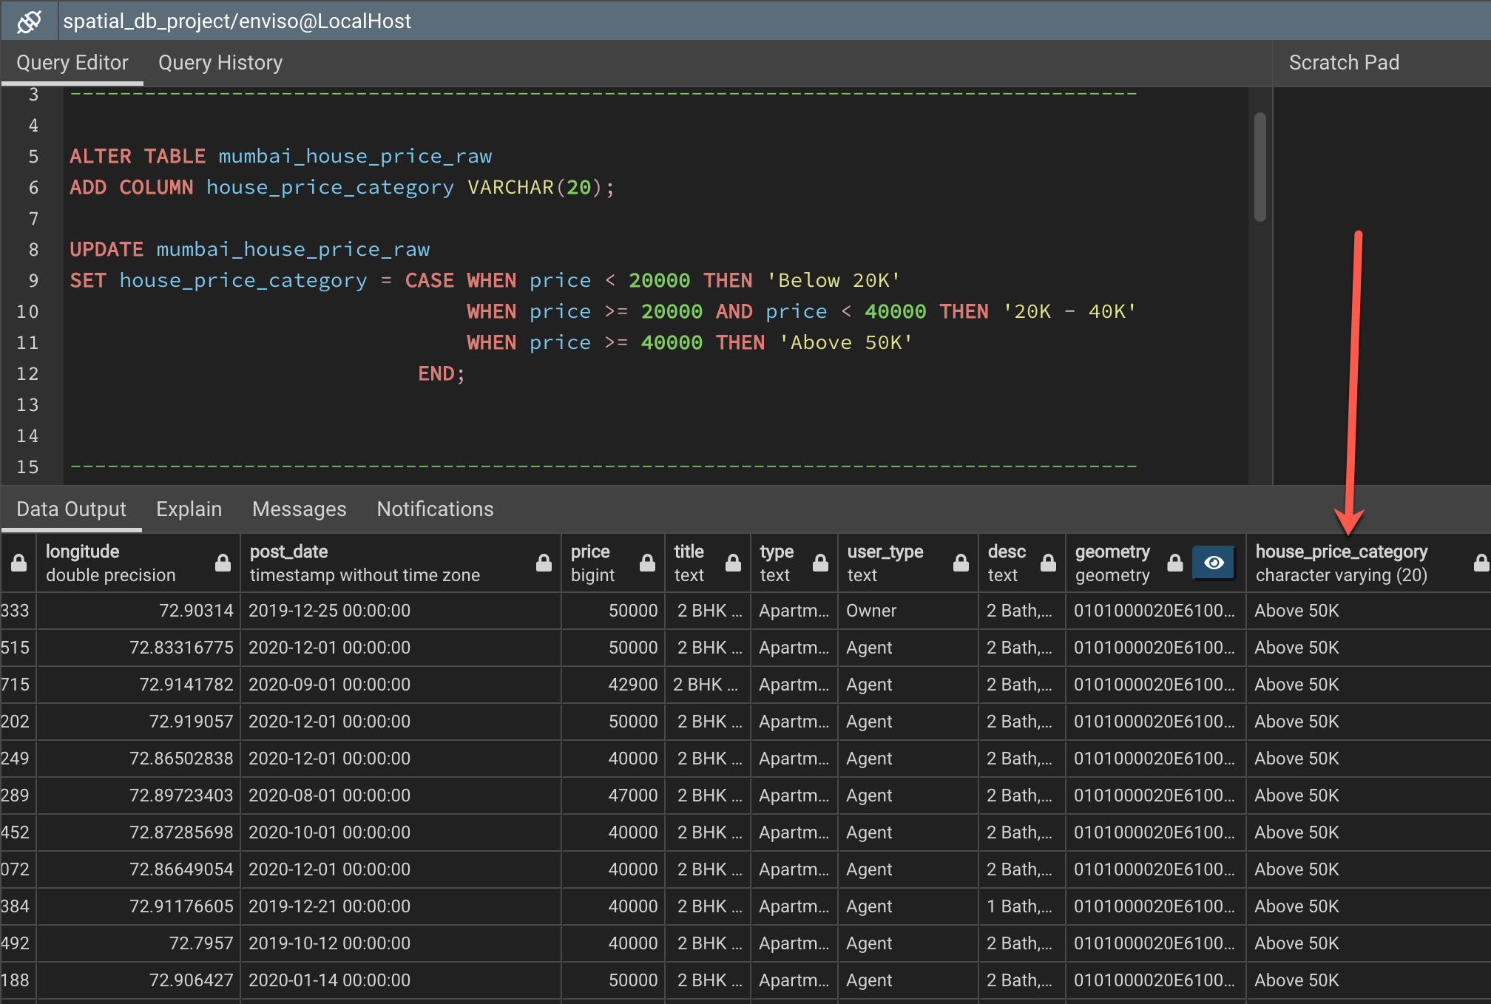
Analysis Analyze the apartments by price range

Slide 9
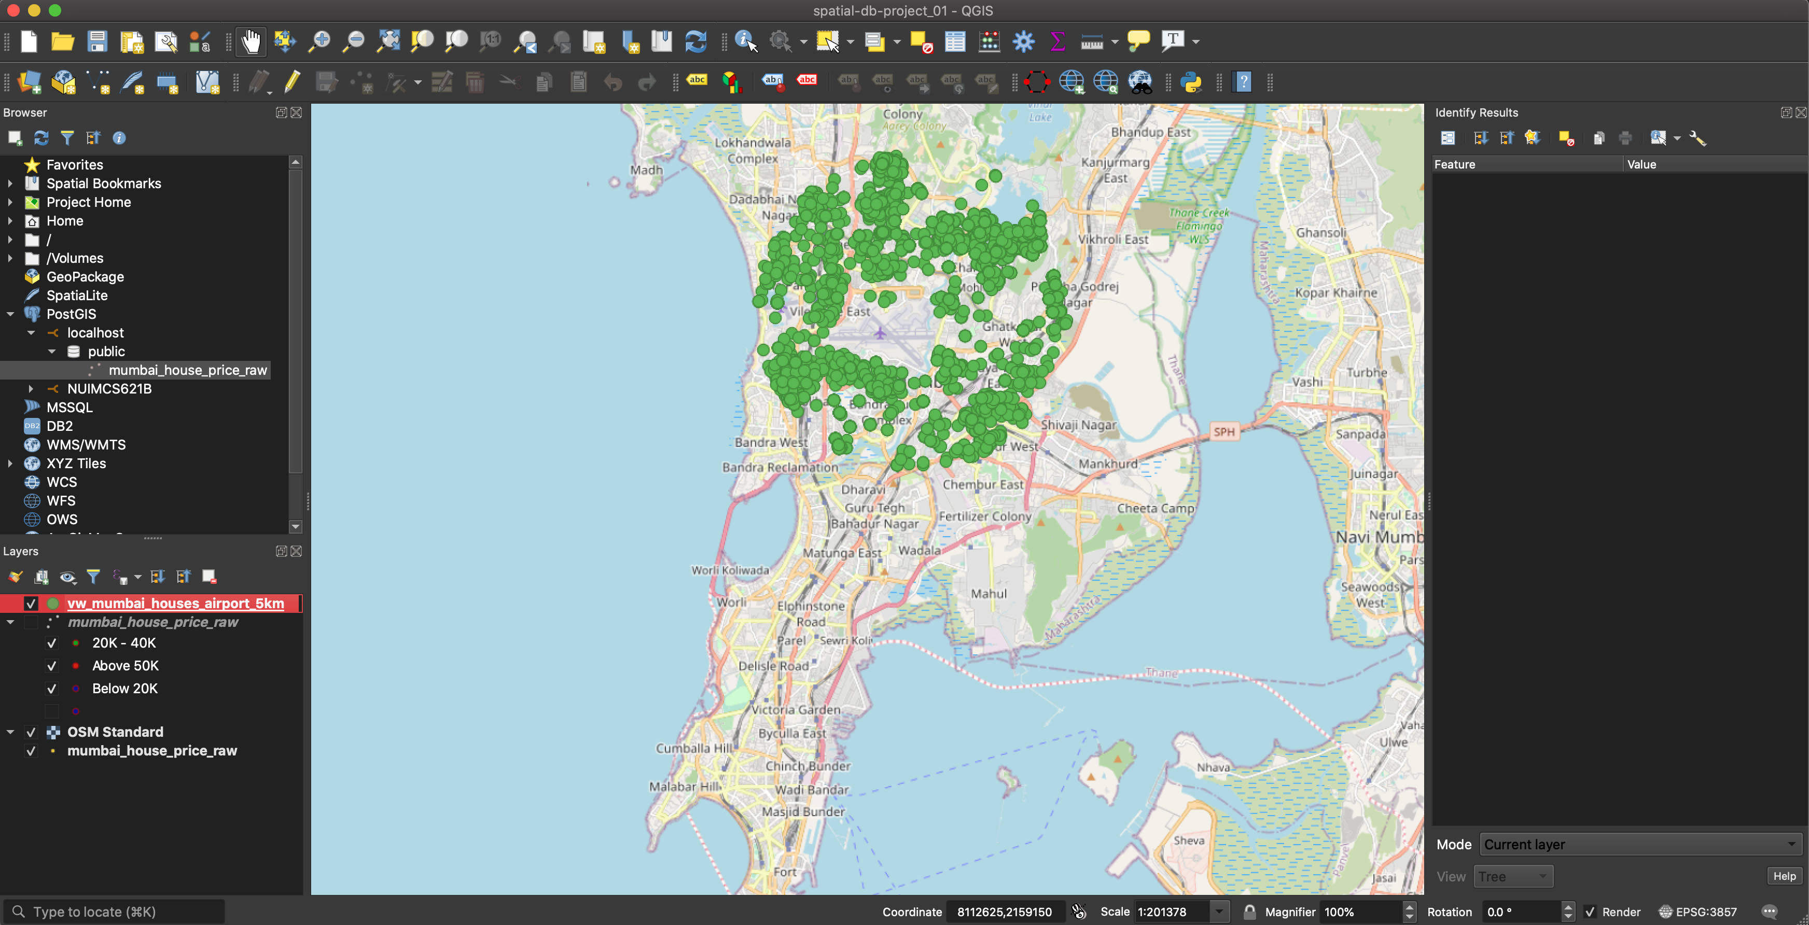
Analysis Find places within the 5km range of the airport

Slide 10
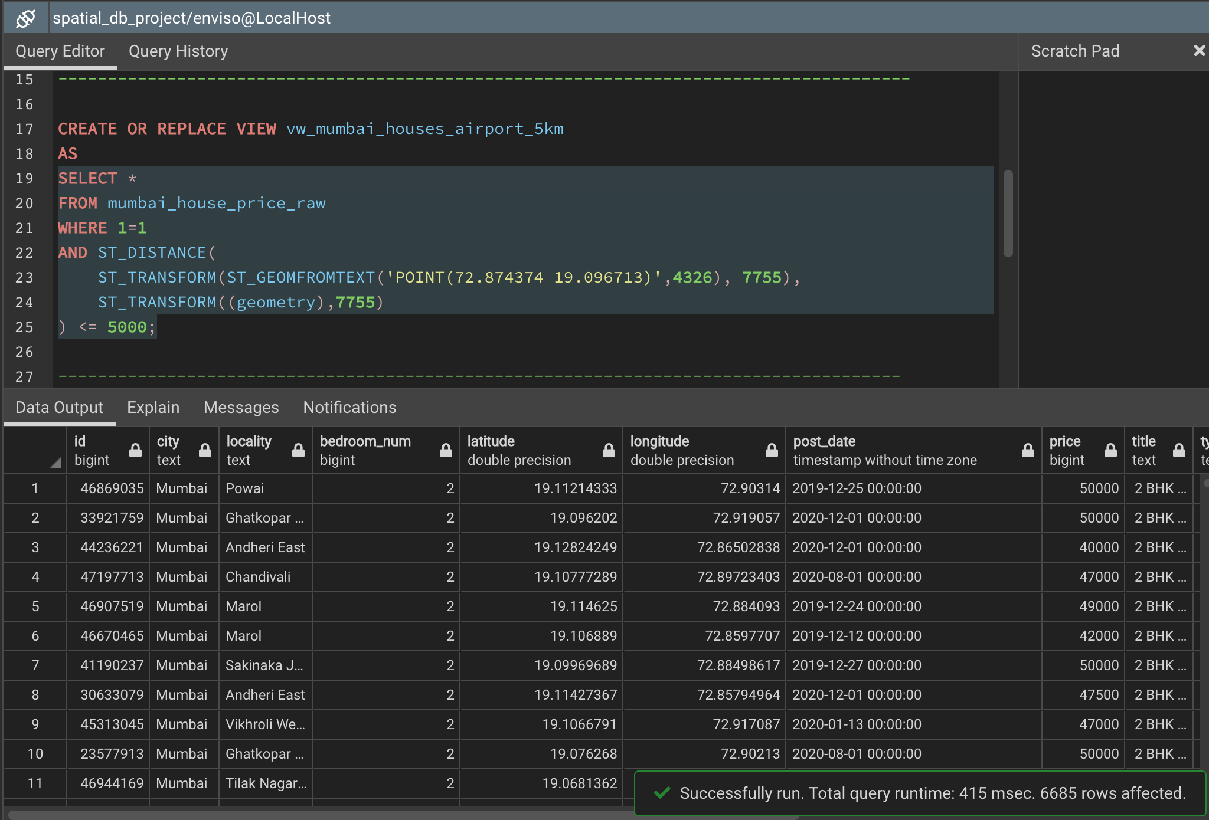
Analysis Find places within the 5km range of the airport

Slide 11
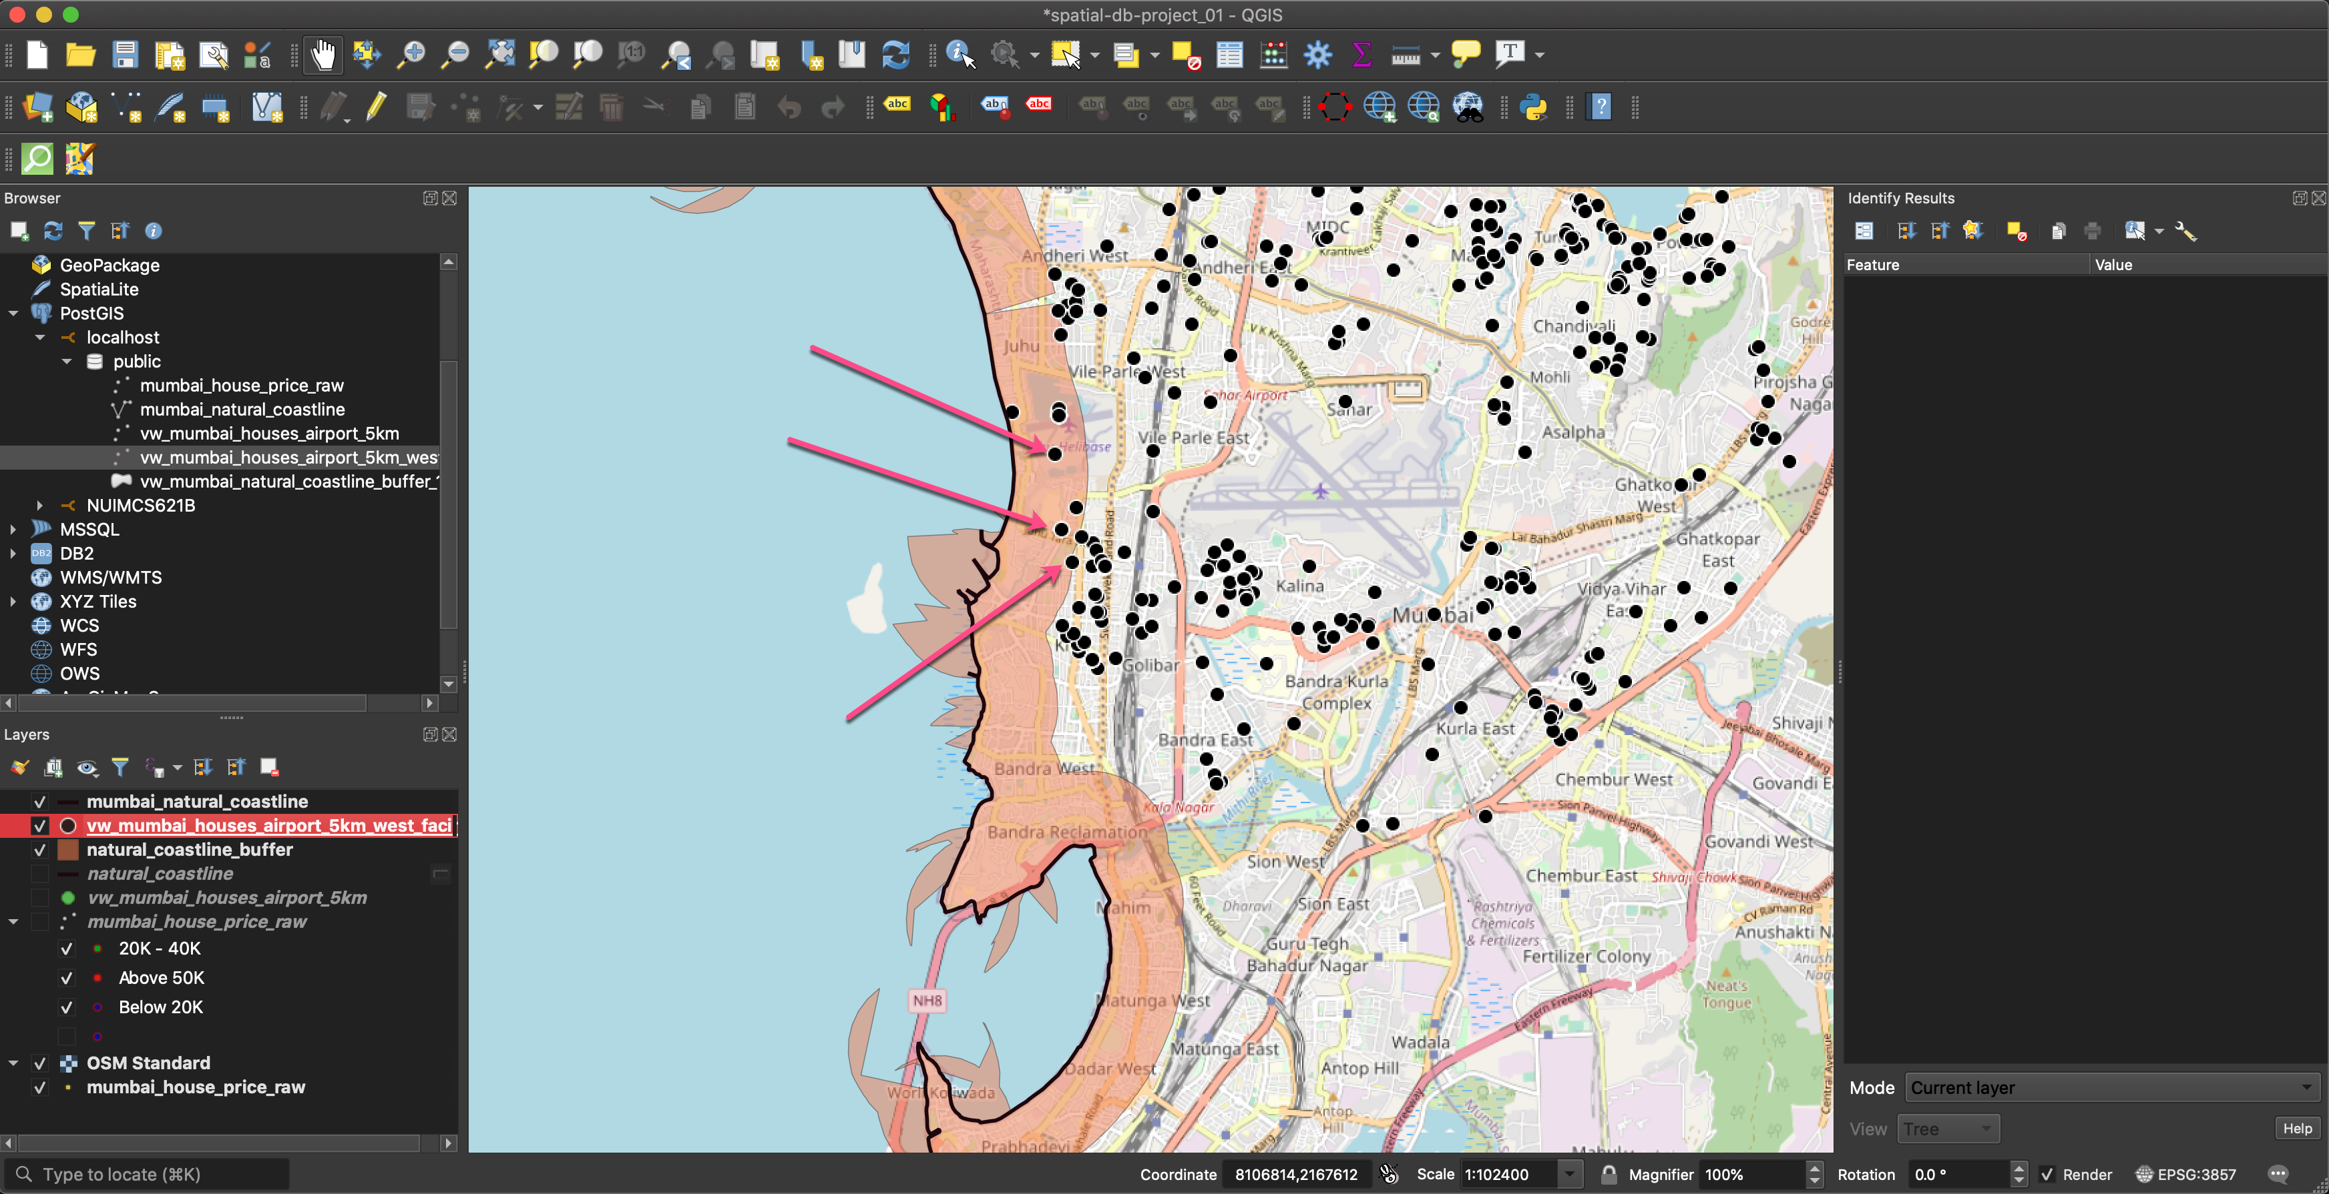
Analysis Select sea facing apartments in that 5km radius

Slide 12
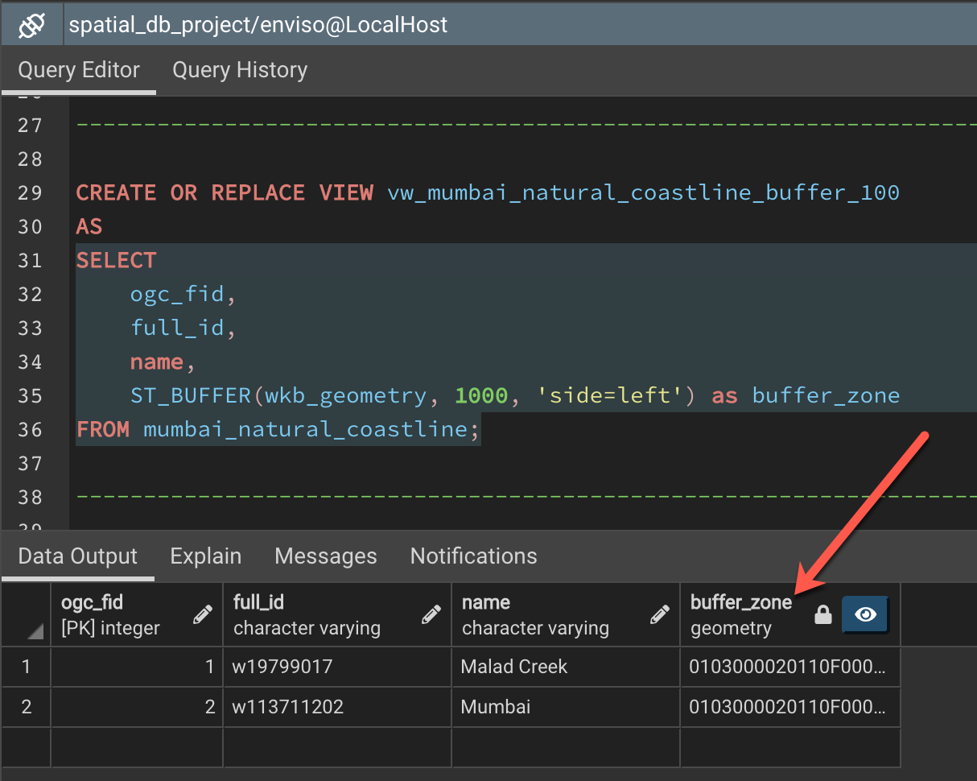
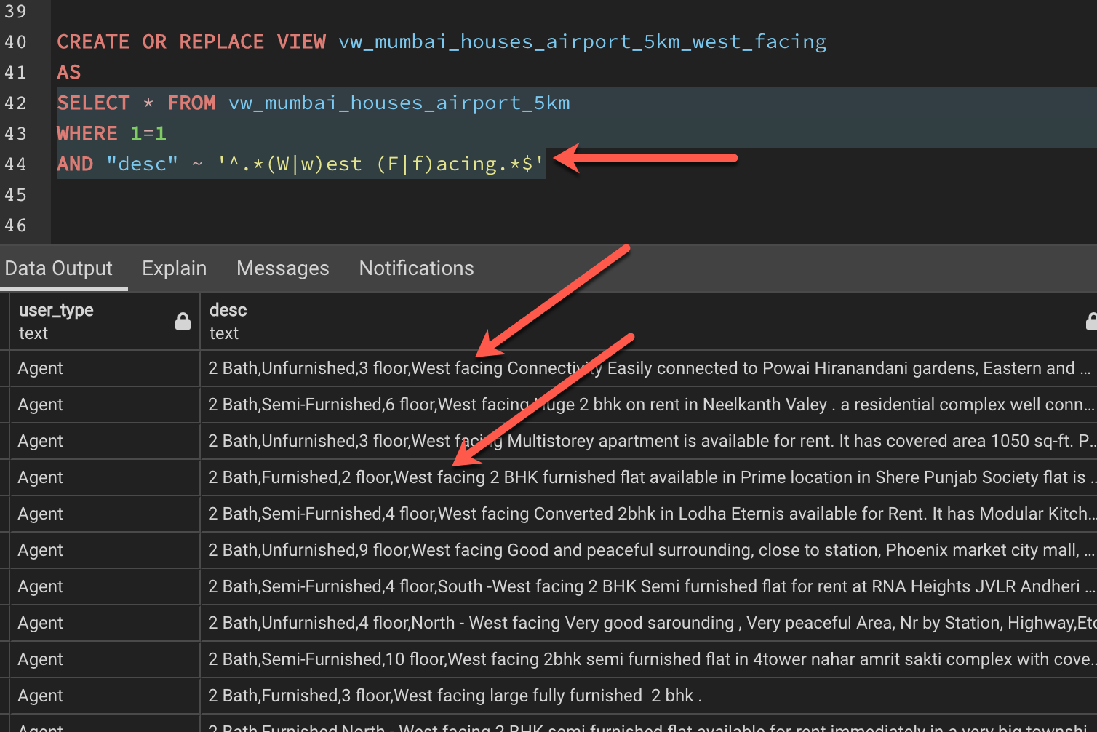
Analysis Select sea facing apartments in that 5km radius

Slide 13
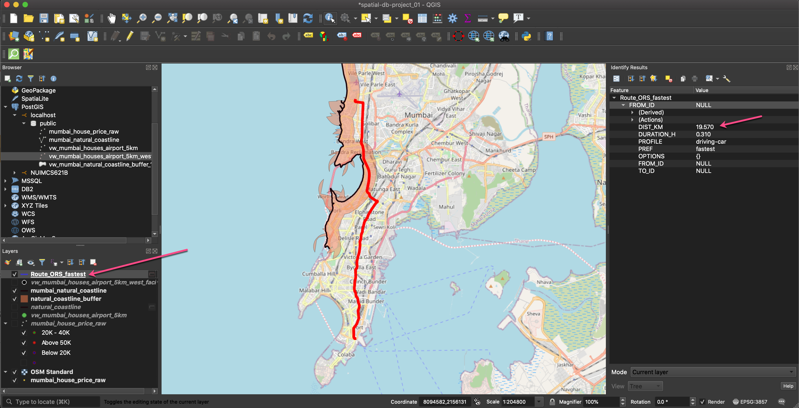
Analysis Select an apartment and calculate the fastest route to Naval Dockyard

Slide 14
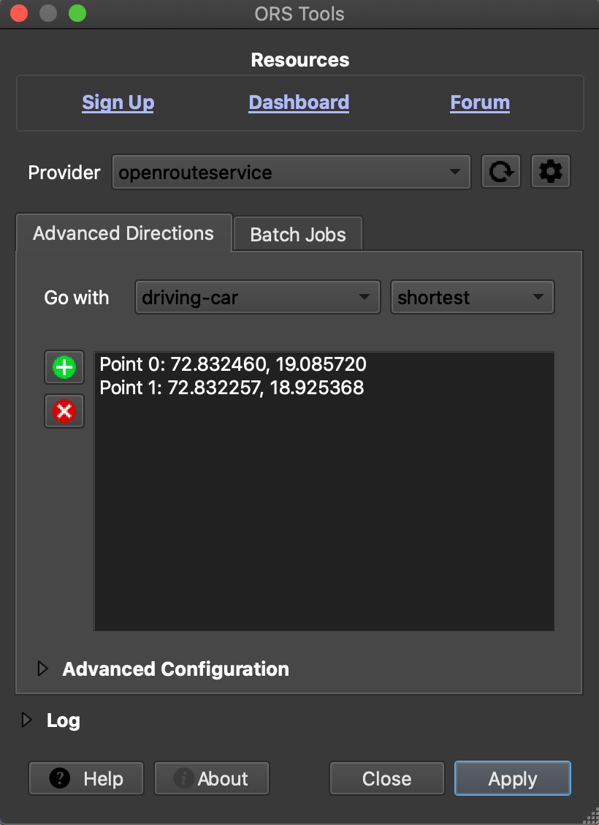
Analysis Select an apartment and calculate the fastest route to Naval Dockyard

Slide 15
Thank You!
Project hosted @ https://github.com/aveek22/cs621-spatial-db

